Slide 1
CS335
Final Project Demo
Group-6

Slide 2
About the Team
Name | Roll Number
Aryan Vora | 200204
S Pradeep | 200826
Yash Gupta | 201144

Slide 3
1.
Milestone 1
Goal-: Scanner, Parser, AST

Slide 4
Lexing and Parsing
Scanning-: For scanning we had used Flex-2.6.4
Parsing-: For parsing we had used Bison-3.8.1
And both of these softwares are implemented in C++.
Grammar-:For this we referred to the official Java documentation from Oracle, but we had to make a few necessary changes so as to remove shift-reduce and reduce-reduce conflicts and make it acceptable by LALR(1) parser.

Slide 5
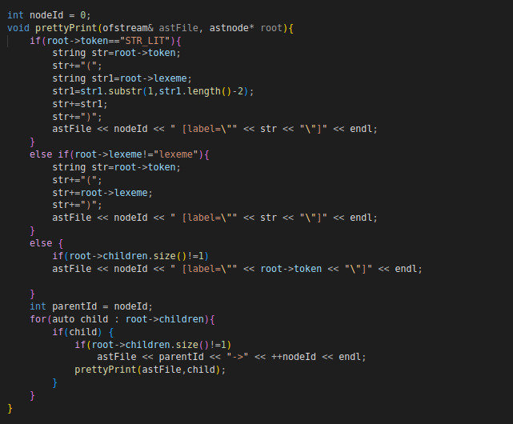
AST
For generating AST, we had written code segment in parser which will itself generates .dot file, and on processing it on graphviz tool finally generates .ps file.

Slide 6
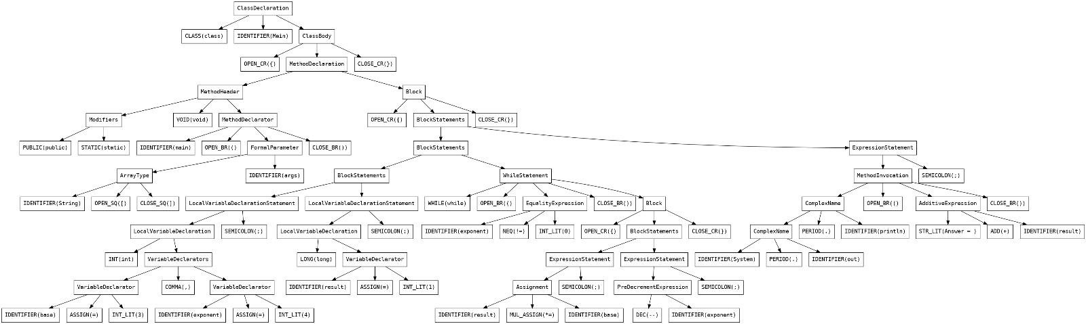
Sample AST

Slide 7
2.
Milestone 2
Goal-: Symbol Table, Type Checking, IR Generation

Slide 8
Symbol Table
We implemented our symbol table as map of string and pointer to Type, where Type is structure holding various fields of symbol table.
For maintaining hierarchical structure we build a global map holding fullscope vs pointer to symbol table.
Also we had maintained the names of imported libraries and Keywords in separate symbol table, which also help us while type checking.

Slide 9
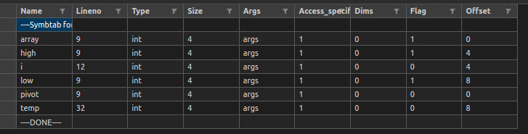
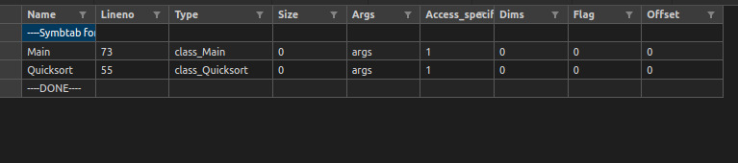
Sample Symbol Table
Case 1: Local variables
Case 2: Class declarations

Slide 10
Three Address Code
For 3AC, we had used Quadruple structure.
And also we had build two helper functions as:
get_tempvar()-: To produce different temp variables.
get_label()-: To produce different labels.
Also to store previously used labels we had maintained different stacks so as to remember previously used labels which are used at times of jumps/goto.

Slide 11
Type Checking
We have checked the compatibility of types with different operators as govern by java rules. For this we have written two helper function-: symtypeEvaluate, symAssignment.
When needed, we perform implicit type conversion.

Slide 12
Simplifications
We have not implemented the following for simplicity:
Function and Operator Overloading
Inheritance
Declarations inside the for loop header

Slide 13
3.
Milestone 3
Goal-: Runtime support for Procedure Calls

Slide 14
Function Calls
We have added functionalities for the calling and return sequence for function calls. Such as:
Pushing and retrieving function arguments from stack
Allocation and deallocation of memory for local variables and temporary variables
Updating BP and SP when transferring control
Maintaining return address in the stack

Slide 15
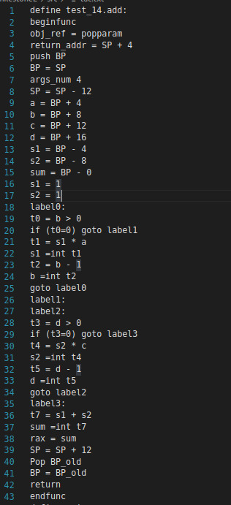
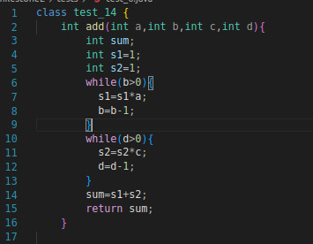
Sample Function Call
Left: Original code
Right: Generated 3AC

Slide 16
4.
Milestone 4
Goal-: Code Generation(x86)

Slide 17
Variable Handling
We handle variables in two ways:
Address Descriptor(only stack portion)
We store the offsets from the base pointer for the location of the variables in the stack in map named stack_var_map.
Register Descriptor
We maintain a map named reg_var_map which stores the variables that each register is holding at that time.

Slide 18
Code Generation
We analyse the tokens in the three address code to select the appropriate x86 instruction.
Tokens corresponding to variables are handled using Address and Register descriptor.

Slide 19
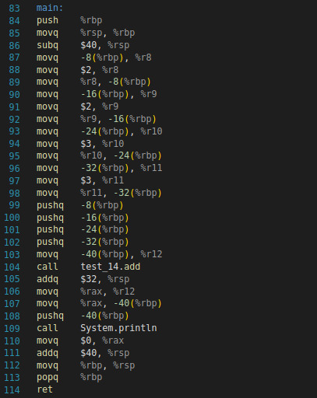
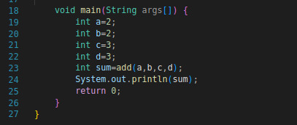
Sample Code Generation
Left: Original code
Right: Generated Assembly code

Slide 20
Supported Feature
Arithmetic operations-: +,-,*,/,%,++,--
Relational operations-: ==,!=,>,<,>=,<=
Bitwise operations-: &,|,^,~,<<,>>
Logical operations-: &&,||
Assignment operations-: =,+=,-=,*=,/=,&=
Branches-: If-Else
Loops-: While, For
Method calls, Println, Modifiers, import, Type Casting

Slide 21
Almost Done
Recursion-: Implemented correctly but slight problems in register allocation during different calls.
Do-While-: Correctly implemented upto 3AC, but there is some minor faults in certain test cases.

Slide 22
Future Goals
Correcting the register allocation problem during recursion.
Correcting the minor faults associated with Do-While.
Code Optimization step.
Inheritance

Slide 23
Contribution
Name | Contribution
Aryan Vora | 33%
S Pradeep | 33%
Yash Gupta | 33%

Slide 24
Thank You!

